Slide 1
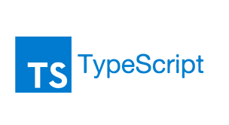
Module 2

Slide 2
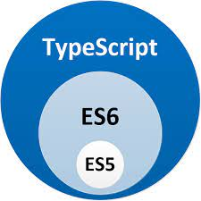
Overview of TypeScript
Open-source
Object-oriented language
Developed and maintained by Microsoft
Licensed under Apache 2 license
it’s just JavaScript, with static typing ie. Typed Javascript
Typed superset of JavaScript that compiles to plain JavaScript using Typescript Compiler which can run on any browser
TypeScript uses the JavaScript syntaxs and adds additional syntaxes for supporting Types
TypeScript files use the .ts
Official website: https://www.typescriptlang.org

Slide 3
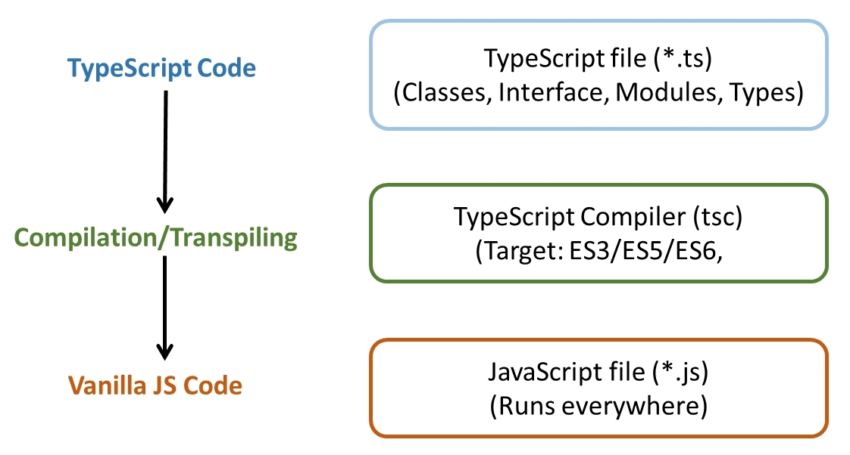
The TypeScript compiler is also implemented in TypeScript and can be used with any browser or JavaScript engines like Node.js.

Slide 4
Why TypeScript?
Catches errors at compile-time, so that you can fix it before you run code.
Supports object-oriented programming features like data types, classes, enums, etc., allowing JavaScript to be used at scale.
TypeScript implements the future features of JavaScript a.k.a ES Next so that you can use them today.

Slide 5
Architecture
Design Goals of Typescript
Statically identify JavaScript constructs that are likely to be errors
strongly-typed programming language and perform static type checking at compile time.
Be a cross-platform development tool
Microsoft released TypeScript under the open source Apache license and it can be installed and executed in all major operating systems.
Impose no runtime overhead on emitted programs
the term design time or compile time to refer to the TypeScript code that is written while designing an application, whereas the term execution time or runtime to refer to the JavaScript code executed after compiling some TypeScript code.

Slide 6
High compatibility with existing JavaScript code
any valid JavaScript program is also a valid TypeScript program (with a few small exceptions)
Provide a structuring mechanism for larger pieces of code
Features like class-based object-orientation, interfaces, namespaces, and modules, help us to structure our code in a much better way.
reduce potential integration issues within the development team
Making code easier to maintain and scale

Slide 7
Impose no runtime overhead on emitted programs
Some features of Typescript are only available at design time. For example, we can declare interfaces in TypeScript, but since JavaScript doesn't support interfaces, the TypeScript compiler will not declare or try to emulate this feature at runtime (in the output JavaScript code

Slide 8
Align with current and future ECMAScript proposals
TypeScript compiler with some mechanisms, such as code transformations (converting TypeScript features into plain JavaScript implementations) and type erasure (removing static type notation), to generate clean JavaScript code.

Slide 9
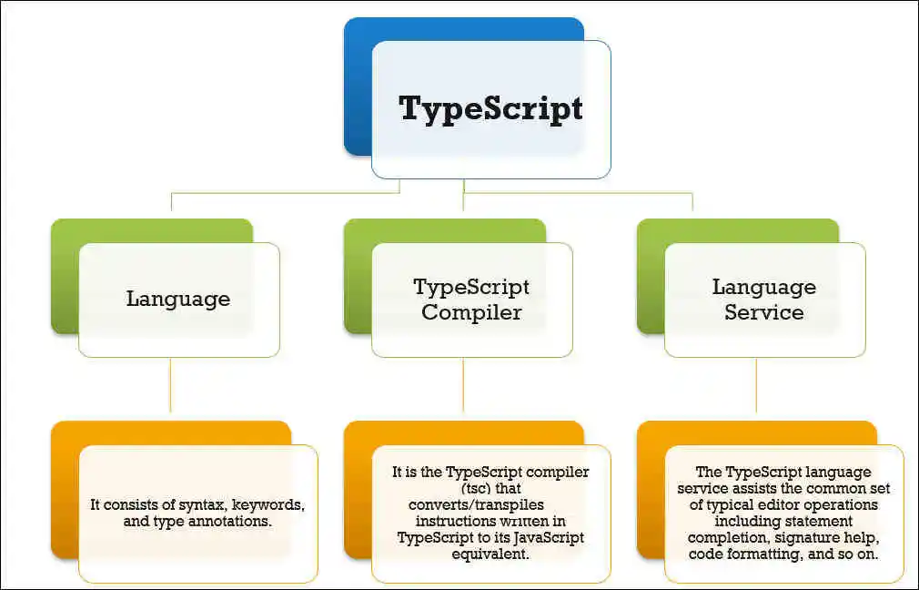
Components of TypeScript

Slide 10
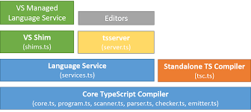
3 major layers

Slide 11
Language:
Features the TypeScript language elements.
It consists of syntax, keywords, and type annotations.
Compiler:
Changes the instructions written in TypeScript to its JavaScript equivalent.
Performs the parsing, type checking, and transformation of your TypeScript code to JavaScript code.
The TypeScript compiler configuration is given in tsconfig.json file.
Language Service:
Generates information that helps editors and other tools provide better assistance features, such as IntelliSense or automated refactoring.
Assists the common set of typical editor operations like statement completion, signature help, code formatting and outlining, colorization, etc.

Slide 12
IDE integration (VS Shim):
The developers of the IDEs and text editors must perform some integration work to take advantage of the TypeScript features. TypeScript was designed to facilitate the development of tools that help to increase the productivity of JavaScript developers.

Slide 13
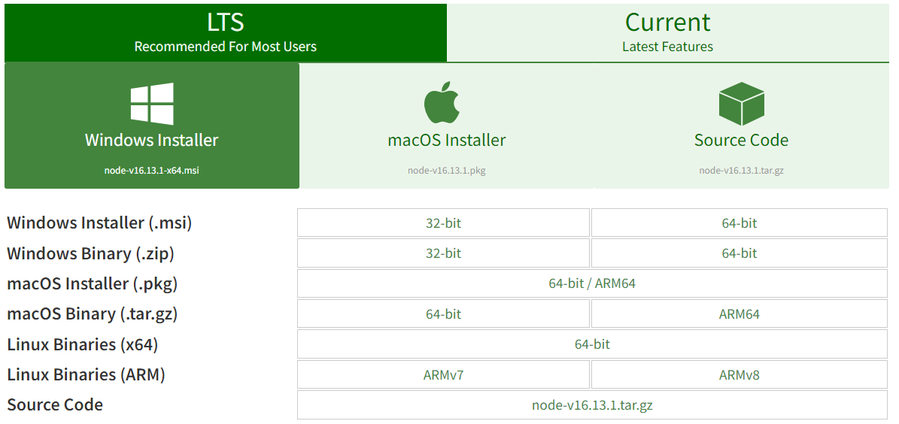

Install TypeScript using Node.js Package Manager (npm) on Windows
Node is available here − https://nodejs.org/en/download
Download and run the .msi installer for Node.
Install Node.js and NPM from Browser
Verify Installation
Also to check the npm version, enter the command npm –v in the terminal window.

Slide 14
How to use TypeScript? ( in production)
Install Node.js
Install TypeScript compiler
Check the current version of the TypeScript compiler:
To Use
npm install -g typescript
tsc --v
tsc <filename.ts>
node <filename.js>
Notes:
https://www.typescripttutorial.net/typescript-tutorial/setup-typescript/

Slide 15
OR in development
Install Node.js and TypeScript compiler
To Use
ts-node is a TypeScript execution engine and REPL for Node.js.
It JIT transforms TypeScript into JavaScript, enabling you to directly execute TypeScript on Node.js without precompiling.
npm install -g ts-node typescript
npx ts-node <filename.ts>
Notes:
https://www.typescripttutorial.net/typescript-tutorial/setup-typescript/

Slide 16
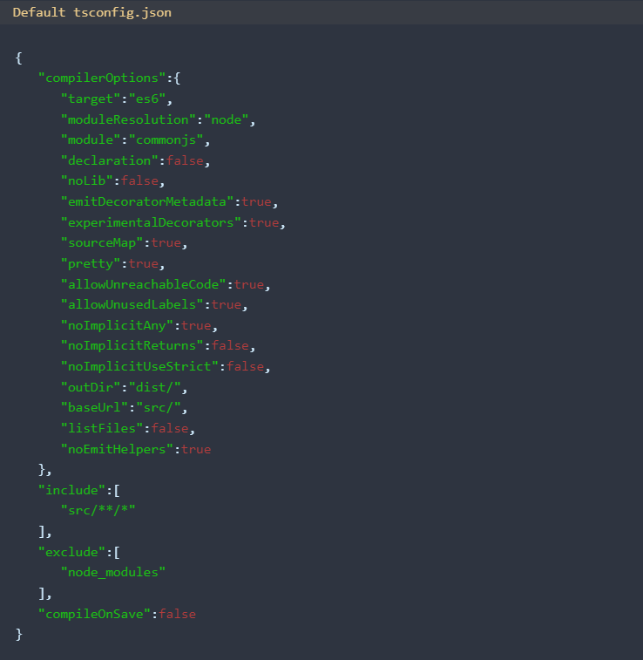

Slide 17
First Program
//FileName: Program1.ts
var message:string="HelloWorld";
console.log(message);
Output: HelloWorld
var message = "HelloWorld";
console.log(message);

Slide 18
TypeScript Features
Cross-Platform/ Portable
Object-Oriented Language
Static type-checking
checking, ensuring that the data flowing through the program is of the correct kind of data.
Type checking cuts down on errors, sets the stage for better tooling, and allows developers to map their programs at a higher level.
In static typing, compiler enforces that values use the same type
let value = 5;
value = "hello"; // error: Type '"hello"' is not assignable to type 'number'.
Notes:
https://thenewstack.io/typescript-and-the-power-of-a-statically-typed-language/#:~:text=And%20TypeScript%20itself%2C%20a%20statically,with%20a%20minimal%20learning%20curve.

Slide 19
// result of concatenating strings
// throws error
Javascript Code
function add(x, y){
return x + y;
}
let result = add(input1.value, input2.value);
console.log(result);
Typescript Code
function add(x: number, y: number):number {
return x + y;
}
let result = add(input1.value, input2.value);
Notes:
Example : JavaScript is dynamically typed. It offers flexibility but also creates many problems.
TypeScript adds an optional type system to JavaScript to solve these problems.

Slide 20
JavaScript is dynamically typed. It offers flexibility but also creates many problems.
TypeScript adds an optional type system to JavaScript to solve these problems.
Optional Static Typing
let value: any = 5;
console.log(value);
value = "hello";
console.log(value);

Slide 21
function add(a: any, b: any): any {
if (typeof a === 'number' && typeof b === 'number') {
return a + b;
}
if (typeof a === 'string' && typeof b === 'string') {
return a.concat(b);
}
}
console.log(add(3,6));
console.log(add("Hello","TypeScript"));

Slide 22
DOM Manipulation
TypeScript can be used to manipulate the DOM for adding or removing elements similar to JavaScript.
ES 6 Features

Slide 23
JavaScript Vs TypeScript
Sr. No. | JavaScript | TypeScript
1. | It doesn't support strongly typed or static typing. | It supports strongly typed or static typing feature.
2. | Netscape developed it in 1995. | Anders Hejlsberg developed it in 2012.
3. | JavaScript source file is in ".js" extension. | TypeScript source file is in ".ts" extension.
4. | It is directly run on the browser. | It is not directly run on the browser.
5. | It is just a scripting language. | It supports object-oriented programming concept like classes, interfaces, inheritance, generics, etc.
6. | In this, number, string are the objects. | In this, number, string are the interface.
7. | Example: <script> function addNumbers(a, b) { return a + b; } var sum = addNumbers(15, 25); document.write('Sum of the numbers is: ' + sum); </script> | Example: function addNumbers(a:number, b:number) { return a + b; } var sum = addNumbers(15, 25); console.log('Sum of the numbers is: ' + sum);

Slide 24
TypeScript Variables
We can declare a variable in one of the four ways:
Declare type and value in a single statement
[keyword] [identifier] : [type-annotation] = value;
Declare type without value. Then the variable will be set to undefined.
[keyword] [identifier] : [type-annotation];
Declare its value without type. Then the variable will be set to any.
[keyword] [identifier] = value;

Slide 25
Declare without value and type. Then the variable will be set to any and initialized with undefined.
[keyword] [identifier];
Note:
Keyword]: It’s a keyword of the variable either var, let or const to define the scope and usage of variable.
[Variable Name]: It’s a name of the variable to hold the values in our application.
[Data Type]: It’s a type of data the variable can hold such as number, string, boolean, etc.
[Value]: Assigning a required value to the variable.

Slide 26
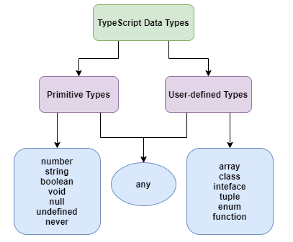
TypeScript Data Types
let identifier: number = value;
let identifier: string = " ";
let identifier: boolean = boolean value;
let identifier: any = value;

Slide 27
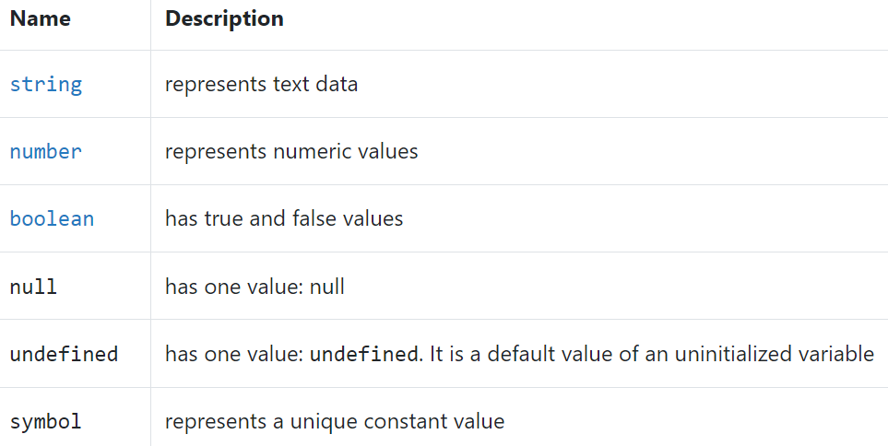
Primitive types

Slide 28
Object types
Object types are functions, arrays, classes, etc.
There are two main purposes of types in TypeScript:
First, types are used by the TypeScript compiler to analyze your code for errors
Second, types allow you to understand what values are associated with variables.
Every value in TypeScript has a type.
A type is a label that describes the properties and methods that a value has.

Slide 29
TypeScript Types with Annotations
let uname: string = "Albert Einstein"; // string
let ulocation: string = "Germany"; // string
let age: number = 38; // number
let isSciencetist: boolean = true; // boolean
console.log("Name:" + uname);
console.log("Location:" + ulocation);
console.log("Age:" + age);
console.log("Is Doctorate:" + isSciencetist);
var uname = "Albert Einstein"; // string
var ulocation = "Germany"; // string
var age = 38; // number
var isSciencetist = true; // boolean
console.log("Name:" + uname);
console.log("Location:" + ulocation);
console.log("Age:" + age);
console.log("Is a Sciencetist:" + isSciencetist);

Slide 30
var Vs let keyword
Sr. No. | Var | let
1. | The var keyword was introduced with JavaScript. | The let keyword was added in ES6 (ES 2015) version of JavaScript.
2. | It has global scope. | It is limited to block scope.
3. | It can be declared globally and can be accessed globally. | It can be declared globally but cannot be accessed globally.
4. | Variable declared with var keyword can be re-declared and updated in the same scope. Example: function varGreeter(){ var a = 10; var a = 20; //a is replaced console.log(a); } varGreeter(); | Variable declared with let keyword can be updated but not re-declared. Example: function varGreeter(){ let a = 10; let a = 20; //SyntaxError: //Identifier 'a' has already been declared console.log(a); } varGreeter();
5. | It is hoisted. Example: { console.log(c); // undefined. //Due to hoisting var c = 2; } | It is not hoisted. Example: { console.log(b); // ReferenceError: //b is not defined let b = 3; }

Slide 31
TypeScript Operators
Arithmetic operators
Comparison (Relational) operators
Logical operators
Bitwise operators
Assignment operators
Ternary/conditional operator
Concatenation operator
Advanced Type Operator

Slide 32
Arithmetic Operators
Operator | Operator_Name | Description | Example
+ | Addition | It returns an addition of the values. | let a = 10; let b = 20; let c = a + b; console.log( c ); // Output 30
- | Subtraction | It returns the difference of the values. | let a = 20; let b = 10; let c = a - b; console.log( c ); // Output 10
* | Multiplication | It returns the product of the values. | let a = 30; let b = 20; let c = a * b; console.log( c ); // Output 600
/ | Division | It performs the division operation, and returns the quotient. | let a = 100; let b = 20; let c = a / b; console.log( c ); // Output 5
% | Modulus | It performs the division operation and returns the remainder. | let a = 75; let b = 20; let c = a % b; console.log( c ); // Output 15
++ | Increment | It is used to increments the value of the variable by one. | let a = 15; a++; console.log( a ); // Output 16
-- | Decrement | It is used to decrements the value of the variable by one. | let a = 15; a--; console.log( a ); // Output 14

Slide 33
Comparison (Relational) Operators
Operator | Operator_Name | Description | Example
== | Is equal to | It checks whether the values of the two operands are equal or not. | let a = 10; let b = 20; console.log(a==b); //false console.log(a==10); //true console.log(10=='10'); //true
=== | Identical(equal and of the same type) | It checks whether the type and values of the two operands are equal or not. | let a = 10; let b = 20; console.log(a===b); //false console.log(a===10); //true console.log(10==='10'); //false
!= | Not equal to | It checks whether the values of the two operands are equal or not. | let a = 10; let b = 20; console.log(a!=b); //true console.log(a!=10); //false console.log(10!='10'); //false
!== | Not identical | It checks whether the type and values of the two operands are equal or not. | let a = 10; let b = 20; console.log(a!==b); //true console.log(a!==10); /false console.log(10!=='10'); //true
> | Greater than | It checks whether the value of the left operands is greater than the value of the right operand or not. | let a = 30; let b = 20; console.log(a>b); //true console.log(a>30); //false console.log(20> 20'); //false
>= | Greater than or equal to | It checks whether the value of the left operands is greater than or equal to the value of the right operand or not. | let a = 20; let b = 20; console.log(a>=b); //true console.log(a>=30); //false console.log(20>='20'); //true
< | Less than | It checks whether the value of the left operands is less than the value of the right operand or not. | let a = 10; let b = 20; console.log(a<b); //true console.log(a<10); //false console.log(10<'10'); //false
<= | Less than or equal to | It checks whether the value of the left operands is less than or equal to the value of the right operand or not. | let a = 10; let b = 20; console.log(a<=b); //true console.log(a<=10); //true

Slide 34
Logical Operators
Operator | Operator_Name | Description | Example
&& | Logical AND | It returns true if both the operands(expression) are true, otherwise returns false. | let a = false; let b = true; console.log(a&&b); /false console.log(b&&true); //true console.log(b&&10); //10 which is also 'true' console.log(a&&'10'); //false
|| | Logical OR | It returns true if any of the operands(expression) are true, otherwise returns false. | let a = false; let b = true; console.log(a||b); //true console.log(b||true); //true console.log(b||10); //true console.log(a||'10'); //'10' which is also 'true'
! | Logical NOT | It returns the inverse result of an operand(expression). | let a = 20; let b = 30; console.log(!true); //false console.log(!false); //true console.log(!a); //false console.log(!b); /false console.log(!null); //true

Slide 35
Bitwise Operators
Operator | Operator_Name | Description | Example
& | Bitwise AND | It returns the result of a Boolean AND operation on each bit of its integer arguments. | let a = 2; let b = 3; let c = a & b; console.log(c); // Output 2
| | Bitwise OR | It returns the result of a Boolean OR operation on each bit of its integer arguments. | let a = 2; let b = 3; let c = a | b; console.log(c); // Output 3
^ | Bitwise XOR | It returns the result of a Boolean Exclusive OR operation on each bit of its integer arguments. | let a = 2; let b = 3; let c = a ^ b; console.log(c); // Output 1
~ | Bitwise NOT | It inverts each bit in the operands. | let a = 2; let c = ~ a; console.log(c); // Output -3
>> | Bitwise Right Shift | The left operand's value is moved to the right by the number of bits specified in the right operand. | let a = 2; let b = 3; let c = a >> b; console.log(c); // Output 0
<< | Bitwise Left Shift | The left operand's value is moved to the left by the number of bits specified in the right operand. New bits are filled with zeroes on the right side. | let a = 2; let b = 3; let c = a << b; console.log(c); // Output 16
>>> | Bitwise Right Shift with Zero | The left operand's value is moved to the right by the number of bits specified in the right operand and zeroes are added on the left side. | let a = 3; let b = 4; let c = a >>> b; console.log(c); // Output 0

Slide 36
Assignment Operators
Operator | Operator_Name | Description | Example
= | Assign | It assigns values from right side to left side operand. | let a = 10; let b = 5; console.log("a=b:" +a); // Output 10
+= | Add and assign | It adds the left operand with the right operand and assigns the result to the left side operand. | let a = 10; let b = 5; let c = a += b; console.log(c); // Output 15
-= | Subtract and assign | It subtracts the right operand from the left operand and assigns the result to the left side operand. | let a = 10; let b = 5; let c = a -= b; console.log(c); // Output 5
*= | Multiply and assign | It multiplies the left operand with the right operand and assigns the result to the left side operand. | let a = 10; let b = 5; let c = a *= b; console.log(c); // Output 50
/= | Divide and assign | It divides the left operand with the right operand and assigns the result to the left side operand. | let a = 10; let b = 5; let c = a /= b; console.log(c); // Output 2
%= | Modulus and assign | It divides the left operand with the right operand and assigns the result to the left side operand. | let a = 16; let b = 5; let c = a %= b; console.log(c); // Output 1

Slide 37
Ternary Operator
expression ? expression-1 : expression-2;
Example:
let num = 10;
let result = (num > 0) ? "True":"False"
console.log(result);
//Output: True

Slide 38
Concatenation Operator
Example:
let message = "Welcome to " + "WebX.0";
console.log("Result of String Operator: " +message);
Output:
Result of String Operator: Welcome to WebX.0

Slide 39
Advanced Type Operators
Operator_Name | Description | Example
in | It is used to check for the existence of a property on an object. | let Bike = {make: 'Honda', model: 'CLIQ', year: 2018}; console.log('make' in Bike); // Output: true
delete | It is used to delete the properties from the objects. | let Bike = { Company1: 'Honda', Company2: 'Hero', Company3: 'Royal Enfield' }; delete Bike.Company1; console.log(Bike); // Output: { Company2: 'Hero', Company3: 'Royal Enfield' }

Slide 40
Operator_Name | Description | Example
typeof | It returns the data type of the operand. | let message = "Welcome to " + "Techneo"; console.log(typeof message); // Output: String
instanceof | It is used to check if the object is of a specified type or not. | let arr = [1, 2, 3]; console.log( arr instanceof Array ); // true console.log( arr instanceof String ); // false

Slide 41
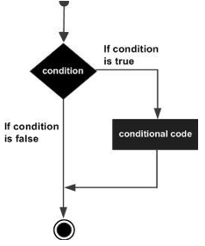
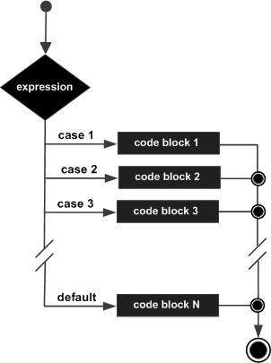
Decision Making in TypeScript
if statement
if...else statement
switch statement

Slide 42
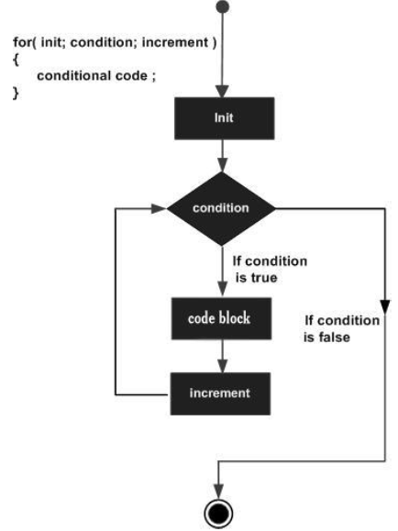
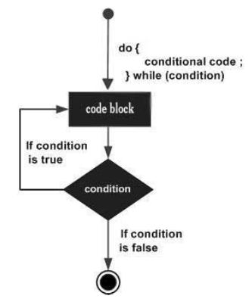
Loops in TypeScript
Definite Loop: for loop
Indefinite Loop: while loop do…while loop

Slide 43
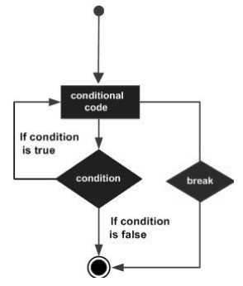
break Statement
var i:number = 1
while(i<=10) {
if (i % 5 == 0) {
console.log ("The first multiple of 5 between 1 and 10 is : "+i)
break //exit the loop if the first multiple is found
}
i++
} //outputs 5 and exits the loop

Slide 44
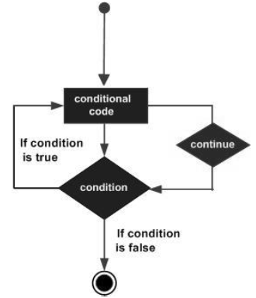
continue Statement
var num:number = 0
var count:number = 0;
for(num=0;num<=20;num++) {
if (num % 2==0) {
continue
}
count++
}
console.log (" The count of odd values between 0 and 20 is: "+count)
Output: The count of odd values between 0 and 20 is: 10

Slide 45
Functions in TypeScript
Functions are the fundamental building block of any applications in JavaScript.
It makes the code readable, maintainable, and reusable.
We can use it to build up layers of abstraction, mimicking classes, information hiding, and modules.
In TypeScript you are likely to find that most functions are actually written as methods that belong to a class.
Notes:
https://learning.oreilly.com/library/view/programming-typescript/9781492037644/ch04.html

Slide 46
Function Aspects
Function declaration
function functionName( [arg1, arg2, ...argN] );
Function definition
function functionName( [arg1, arg2, ...argN] ){
//code to be executed
}
Function call
FunctionName();

Slide 47
Function Creation
We can create a function in two ways. These are:
Named Function
Syntax: functionName( [arguments] ) { }
Example:
//Function Definition
function display() {
console.log("Hello WebX.0!");
}
//Function Call
display();// Hello WebX.0!

Slide 48
2. Anonymous Function
Syntax: let res = function( [arguments] ) { }
Example:
// Anonymous function
let myAdd = function (x: number, y: number) : number {
return x + y;
};
// Anonymous function call
console.log(myAdd(2,3)); // 5

Slide 49
Each parameter can be given a type annotation.
When the function is called, the type of each argument passed to the function is checked.
There is an additional type annotation outside of the parentheses that indicates the return type.

Slide 50
Optional Parameters
In JavaScript, it is possible to call a function without supplying any arguments, even where the function specifies parameters. It is even possible in JavaScript to pass more arguments than the function requires.
In TypeScript, the compiler checks each call and warns you if the arguments fail to match the required parameters in number or type.
Because arguments are thoroughly checked, you need to annotate optional parameters to inform the compiler that it is acceptable for an argument to be omitted by calling code.

Slide 51
function getAverage(a: number, b: number, c ? : number): string {
var total = a;
var count = 1;
total += b;
Count++;
if (typeof c !== 'undefined') {
total += c; count++; }
var average = total / count;
return 'The average is ' +average;
}

Slide 52
Default Parameters
When you specify a default parameter, it allows the argument to be omitted by calling code and in caseswhere the argument is not passed the default value will be used instead.
Default parameters are complementary to optional parameters.

Slide 53
function concatenate(items: string[], separator = ',' , beginAt = 0
, endAt = items.length ) {
var result = '';
for (var i = beginAt; i < endAt; i++) {
result += items[i];
if (i < (endAt - 1)) {
result += separator; }
}
return result;
}
var items = ['A', 'B', 'C']; // 'A,B,C'
var result = concatenate(items); // 'B-C'
var partialResult = concatenate(items, '-', 1);

Slide 54
Rest Parameters
Rest parameters allow calling code to specify zero or more arguments of the specified type.
For the arguments to be correctly passed, rest parameters must
follow these rules
Only one rest parameter is allowed.
The rest parameter must appear last in the parameter list.
The type of a rest parameter must be an array type.

Slide 55
function getAverage( ... a: number[]): string {
var total = 0; var count = 0; for (var i = 0; i < a.length;i++) {
total += a[i]; count++;
}
var average = total / count; return 'The average is ' +average;
}
var result = getAverage(2, 4, 6, 8, 10); // 'The average is 6'

Slide 56
Overloads
In many languages, each overload has its own implementation but in TypeScript the overloads all decorate a single implementation.
When you call a function that has overloads defined, the compiler constructs a list of signatures and attempts to determine the signature that matches the function call.
If there are no matching signatures the call results in an error.

Slide 57
// Function overload for string parameters
function getAverage(a: string, b: string, c: string): string;
// Function overload for number parameters
function getAverage(a: number, b: number, c: number): string;
// Function implementation
function getAverage(a: string | number, b: string | number, c: string | number): string {
var total = parseInt(a as string, 10) + parseInt(b as string, 10) + parseInt(c as string, 10);
var average = total / 3;
return 'The average is ' + average;
}
var result = getAverage(4, 3, 8); // Result: 'The average is 5'
console.log(result);

Slide 58
Arrow Function (Lambda Function)
It omits the function keyword.
uses fat arrow (=>)
It is also called a Lambda function.
The arrow function has lexical scoping of "this" keyword
Syntax: (parameter1, parameter2, ..., parameterN) => expression;

Slide 59
Arrow function with Parameter
let sum = (x: number, y: number): number => {
return x + y;
}
console.log(sum(10, 20)); //returns 30
Arrow function without a parameter
let Print = () => console.log("Hello TypeScript");
Print(); //Output: Hello TypeScript

Slide 60

TypeScript Classes and Objects
In object-oriented programming languages like Java and C#, classes are the fundamental entities used to create reusable components.
TypeScript introduced classes to avail the benefit of object-oriented techniques like encapsulation and abstraction.
The class in TypeScript is compiled to plain JavaScript functions by the TypeScript compiler to work across platforms and browsers.
A class definition can contain the following properties:
Fields: It is a variable declared in a class.
Methods: It represents an action for the object.
Constructors: It is responsible for initializing the object in memory.
Nested class and interface: It means a class can contain another class.

Slide 61
Syntax to declare a class
A class keyword is used to declare a class in TypeScript. We can create a class with the following syntax:
class <class_name>{
field;
method;
}
Object Creation
Syntax: let object_name = new class_name(parameter)

Slide 62
Object Initialization
Object initialization means storing of data into the object.
There are three ways to initialize an object. These are:
1. By Reference Variable
2. By Method
3. By Constructor

Slide 63
TypeScript Inheritance
Inheritance is the ability of a program to create a new class from an existing class.
It is a mechanism which acquires the properties and behaviors of a class from another class.
The class whose members are inherited is called the base class, and the class that inherits those members is called the derived/child/subclass.

Slide 64



In child class, we can override or modify the behaviors of its parent class.
The TypeScript uses class inheritance through the extends keyword.
TypeScript supports only single inheritance and multilevel inheritance. It doesn't support multiple and hybrid inheritance.
We can use inheritance for Method Overriding (so runtime polymorphism can be achieved) and code reusability.

Slide 65
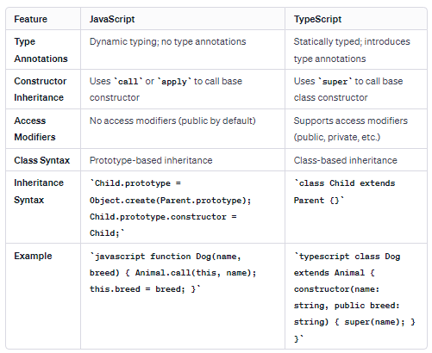
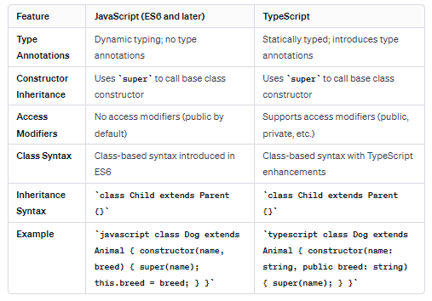
Before ES 6 After ES 6

Slide 66






TypeScript Interfaces
An Interface is a structure which acts as a contract in our application.
used to enforce the implementation of specified properties or methods on an object.
JavaScript doesn’t support interfaces, but TypeScript does.
It defines the syntax for classes to follow.
We cannot instantiate the interface, but it can be referenced by the class object that implements it.
The interface contains only the declaration of the methods and fields, but not the implementation.

Slide 67

An interface can declare not only properties but also methods (no implementations though).
A class declaration can then include the implements keyword followed by the name of the interface. In other words, while an interface just contains method signatures, a class can contain their implementations.
Syntax:
interface interface_name {
// variables' declaration
// methods' declaration
}

Slide 68
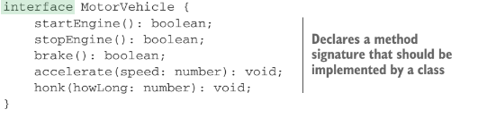
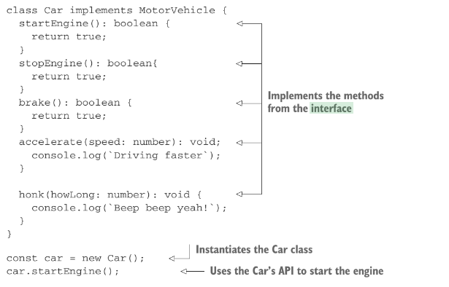


Slide 69
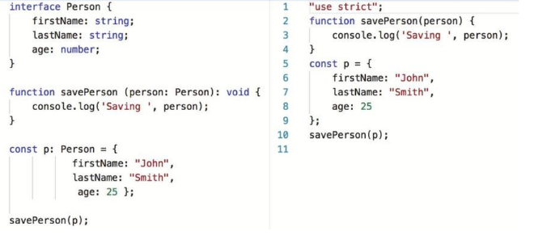
Using interfaces as custom types
ts .js

Slide 70

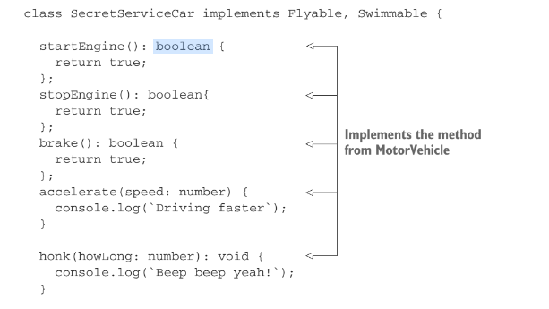
combining classes and interfaces brings flexibility to code design.
option—extending an interface.

Slide 71
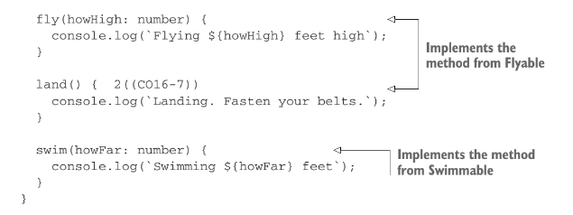

Slide 72
Generics
function printData<T>(data: T) {
console.log("data: ", data);
}
printData(2);
printData("hello");
printData(true);

Slide 73
TypeScript Modules
A module is a way to create a group of related variables, functions, classes, and interfaces, etc.
It executes in the local scope, not in the global scope.
We can create a module by using the export keyword and can use in other modules by using the import keyword.
Modules import another module by using a module loader.
The most common modules loaders which are used in JavaScript are the CommonJS module loader for Node.js and require.js for Web applications.

Slide 74
Steps:
Module Creation
Accessing the module in another file by using the import keyword.
Compiling and Execution of Modules

Slide 75
Example: Let us understand the module with the following example.
1. Module Creation
//FileName: addition.ts
export class Addition{
constructor(private x: number, private y: number){
}
Sum(){
console.log("SUM: " +(this.x + this.y));
}
}
2. Accessing the module in another file by using the import keyword.
//FileName: app.ts
import {Addition} from './addition';
let addObject = new Addition(10, 20);
addObject.Sum();

Slide 76
3. Compiling and Execution of Modules
Open the terminal and go to the location where you stored your project. Now, type the following command in the terminal window.
--module <target> <file path>
Use of the above targets depend on the application and module loader you are using.
$ tsc --module commonjs app.ts
$ node ./app.js
4. Output:
SUM: 30

Slide 77
References
Yakov Fain and Anton Moiseev, “TypeScript Quickly”, Manning Publications.
https://drive.google.com/file/d/164stbHHyQIWB_y8s90oTnS-SoFrxc6S_/view?usp=share_link
Steve Fenton, “Pro TypeScript: Application - Scale Javascript Development”, Apress
https://drive.google.com/file/d/1ma-ju9yrbBD_DrqSdJCtDkQZHB2czk85/view?usp=share_link
Boris Cherny, “Programming TypeScript- Making Your Javascript Application Scale”, O’Reilly Media Inc.
https://drive.google.com/file/d/1mf49NTqLRjhHZDET_bT1WYgk1B5VaEBa/view?usp=sharing
https://www.javatpoint.com/typescript-tutorial
https://www.tutorialsteacher.com/typescript
Typescript in 50 Lessons
https://drive.google.com/file/d/1mhUttBaMxiP7XUArNV3QUxLSFtM0CaWu/view?usp=share_link

